Slide 1


Module: FNP
Membrane potential and the basis of cellular excitability & Action potential
Lecture :
Dr Ratnadeep Saha
Email: r.saha@bham.ac.uk
Notes:
Introduction to biological basis of electrical excitability and how used in communication in the body.
Two lectures – membrane physiology and then action potential

Slide 2
Learning Outcome
You should be able to understand and explain the principles by which neurons generate electrical signals.
Should be able to explain the part played by the cell membrane, ion channels and ion pumps in generating and maintaining the RMP

Slide 3
What we will cover for membrane potential
What excitable cells are (specially neurons) and how do they communicate
Concept of Ionic concentration gradients & Electrochemical gradient across cells and how they are maintained
Equilibrium potentials and how they are achieved
Resting membrane potential and how it is achieved
Impact of extracellular ion concentration changes

Slide 4
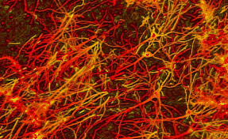
What are Excitable cells?
Ability of cells to be get excited resulting in the generation of action potentials. Neurons, muscle cells (skeletal, cardiac, and smooth), some endocrine cells are some examples.
No Physical isolation; They prefer to stay in groups and have close interconnection with one another.
2 x 10¹²
(2 billion!)

Slide 5

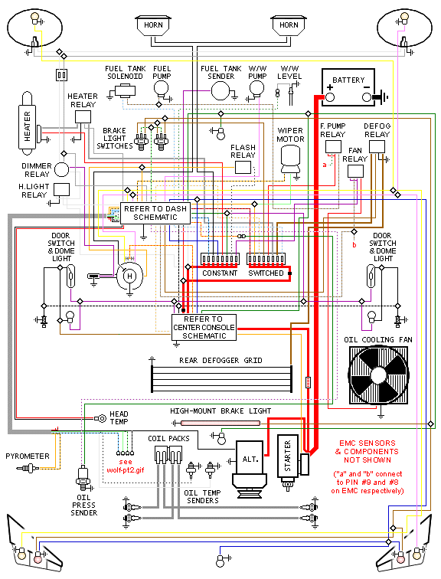
Brain has extensive interactions within its own part & the bodily neurons
Neurones enables tremendous computational power

Slide 6
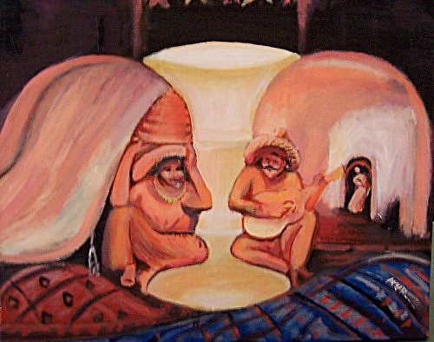
How many person you could recognize?

Slide 7

What are the actual camels in this picture?

Slide 8

Who is being lifted by the boy his picture?

Slide 9

Can you say where this Autumn leaves are placed in this picture?

Slide 10
Message:
Our brain interpret any picture subconsciously based on our previous experiences and expectation in split seconds but if the pictures are a bit odd (did not see earlier), brain could take longer time to recognize it in a meaningful way.
Basis: Tremendous computational Power (Enabled by Neural structure)

Slide 11
How do neurones work? ➔
How do the interconnections
work? ➔

Slide 12
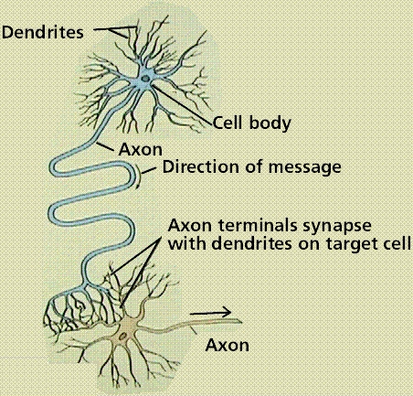
How neurons communicate
Four regions
The ‘message’ is an electrical impulse called an action potential (A.P.)
The A.P initiates
synaptic transmission
at the nerve terminal convey message to the next cell

Slide 13
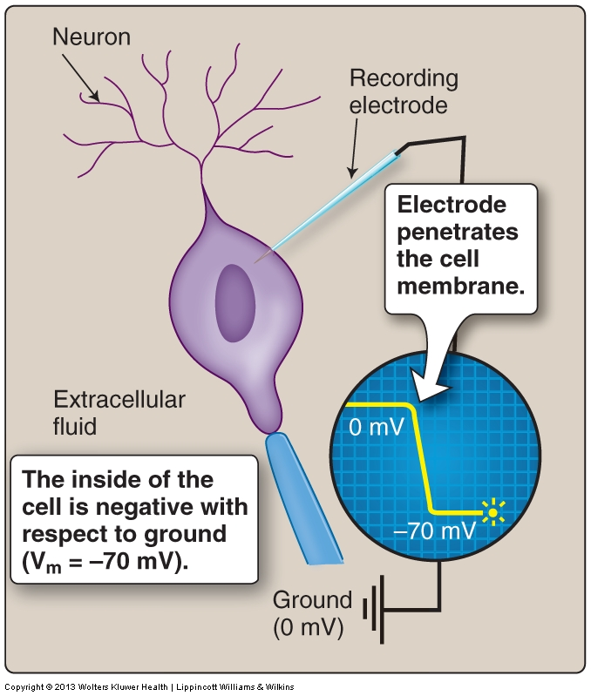
Membrane potential (Vm)
Voltage across the membrane at any moment = Vm
Vm can change over time
Typical neuron membrane potential (@ rest) is approx. -70mV
Absolute requirement functioning nervous system
To understand the negative membrane potential
Consider:
Properties of the cell membrane
Ionic concentrations inside and outside of the cell
Notes:
Membrane potential is the voltage across the cell membrane at any moment and is represented by Vm.
When cell is not active it is at rest, Vm is the resting membrane potential.
Vm can change over time – for example during an action potential the membrane potential changes

Slide 14
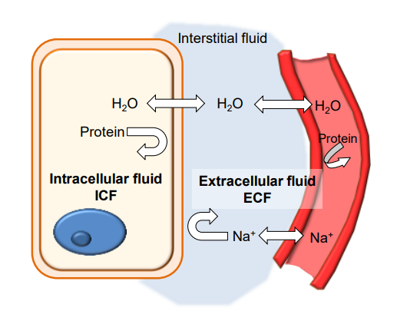
ICF versus ECF
Cell membrane is impermeable to any particles that are hydrophilic
Cell membrane influences the composition of the intracellular environment
Cell membrane establish distinctive internal environments (specific anions and cations)
Inside and outside of the cell membrane exists in aqueous surroundings
Let see, at the cellular level …..
Notes:
Cell membrane – phospholipid bilayer is impermeable to ions.

Slide 15
How is membrane potential maintained and how does it change?
Like all cells, excitable cells have lipid bilayer membranes, with embedded proteins.
Notes:
This type of imbedded proteins (used here) are integral proteins that traverses across the membrane from one side to the other and represents a variety of ion channels, receptors, adhesion proteins (integrin, cadherin etc) etc.

Slide 16
Like all cells, excitable cells have lipid bilayer membranes, with embedded proteins.
ICF
ECF
K+
150
K+
5 mM

Slide 17
Like all cells, excitable cells have lipid bilayer membranes, with embedded proteins.
ICF
ECF
K+
150
K+
5 mM
Na+
15
Na+
150

Slide 18
Like all cells, excitable cells have lipid bilayer membranes, with embedded proteins.
ICF
ECF
K⁺
150
K⁺
5 mM
Na⁺
15
Na⁺
150
Cl⁻
9
Cl⁻
125
protein
45
protein
0.1
Notes:
Potassium ions are mostly internalized along with the proteins whereas the sodium and chlorides are placed externally. So a clear variation of distribution of ions are visible across the either side of the membrane.

Slide 19
This unequal distribution of ions leads to a slight negative charge inside the membrane -- the Resting Membrane Potential (RMP)
The RMP is maintained by:
  the high permeability of the membrane to K⁺ (This is the main)
  the active transport of Na⁺ (Outside) across the membrane (Supportive role)
both via transmembrane proteins

Slide 20
The transmembrane proteins form ion channels, allowing ions to cross the membrane.
ICF
ECF
1) the K+ leak channel

Slide 21
K+ flows out of cell down its concentration gradient.
ICF
ECF
1) the K+ leak channel
K+
K+
K+
K+
K+
K+
K+
K+
K+
K+
K+

Slide 22
K+ flows out of cell down its concentration gradient.
ICF
ECF
1) the K+ leak channel
K+
K+
K+
K+
K+
K+
K+
K+
K+
K+
K+

Slide 23
This movement of K+ down its concentration gradient causes a slight accumulation of +ve charges on the outside of cell membrane.
ICF
ECF
1) the K+ leak channel
K+
K+
K+
+
K+
K+
-
+
-
K+
K+
K+
K+
K+
K+

Slide 24
But K+ is not the only ion around.
ICF
ECF
1) the K+ leak channel
Na+
K+
K+
Na+
Na+
K+
K+
Na+
Na+
K+
Na+
K+
K+
Na+
K+
Na+
Na+
K+
Na+
Na+
Na+
Na+

Slide 25
But the Na+ pump pulls Na+ out of the cell.
ICF
ECF
1) the K+ leak channel
Na+
Na+
K+
Na+
Na+
K+
K+
K+
2) the Na+ pump
(Na+/K+ ATPase)
K+
K+
K+
Na+
Na+
Na+
K+
K+
K+
Na+
Na+
K+
Na+
Na+
Na+
K+
Na+

Slide 26
But the Na+ pump pulls Na+ out of the cell, and at the same time pushes K+ into the cell.
ICF
ECF
1) the K+ leak channel
Na+
Na+
K+
Na+
Na+
K+
K+
K+
2) the Na+ pump
(Na+/K+ ATPase)
K+
K+
K+
K+
Na+
Na+
K+
K+
Na+
Na+
Na+
K+
Na+
Na+
Na+
K+
Na+

Slide 27
The Na+ pump is Electrogenic : it creates a slight positive charge on the outside.
ICF
ECF
1) the K+ leak channel
Na+
Na+
K+
Na+
Na+
K+
K+
K+
2) the Na+ pump
(Na+/K+ ATPase)
-
+
-
+
K+
2 K+
3 Na+
pumps Na+ out of cell via active transport

Slide 28
These two transmembrane proteins ensure that the membrane has a slight negative charge on the inside, relative to the outside.
ICF
ECF
1) the K+ leak channel
Na+
Na+
K+
Na+
Na+
K+
-
+
K+
-
+
K+
-
+
2) the Na+ pump
(Na+/K+ ATPase)
-
+
K+
2 K+
3 Na+
pumps Na+ out of cell via active transport

Slide 29
How big is the electrical difference?
When will K+ stop moving?
ICF
ECF
K+
K+
K+
-
+
K+
K+
-
+
-
-
K+
++
K+
K+
K+
concentration
K+
K+
electrical
An electrical gradient acts in opposite direction to concentration gradient and disfavour K+ exit out of the cell. Initially this remains small but gradually strengthens.
Notes:
Note: Initially, because of the concentration gradient difference, ions will move across the membrane very easily. This results in gradual accumulation of positive charges outside compared to inside. Now as the process go on, positive ions keep on building outside which eventually tend to inhibit the fruitful movement of K+ ions to outside as we know the similar charges repels and opposite charges attracts one another. What we term this as “electrical gradient”, acts in opposite direction to concentration gradient and disfavour K+ exit out of the cell. Initially it remains lesser in strength compared to concentration gradient, but as the process continues, there will be one time at which it will be equal and fully stop the exit of K+ or you could say no resultant gain of K+ will occur outside the membrane [ie: Physically whatever the number of K+ ions will come out due to concentration gradient will re-enter again due to electrical gradient].

Slide 30
K+ will stop moving when the electrical gradient is equal and opposite to the concentration gradient.
ICF
ECF
K+
K+
K+
K+
+
K+
K+
-
+
-
-
-
++
K+
K+
K+
K+
concentration
K+
K+
electrical
The voltage at which this occurs = the Equilibrium Potential (E_{K})

Slide 31
The equilibrium potential (E_{ion}) can be determined:
The Nernst Equation:
  E_{ion} = -RT ln [ion]_{in}
  zF [ion]_{out}
  R = Gas constant; 8.135 J K⁻¹ mol⁻¹
  T = Absolute temperature in K; (273 + temp in ºC)
  z = Valence of ion ((K+/Na⁺ is one, Ca²⁺ is two and Cl⁻ is one)
  F = Faraday constant ; 9.684 x 10⁴ C mol⁻¹
Notes:
R = Gas constant, 8.135 J K⁻¹ mol⁻¹
T = temperature in K (273 + temp in ºC)
z = valency of ion (K+/Na⁺ is one, Ca²⁺ is two and Cl⁻ is one)
F = Faraday’s constant, 9.684 x 10⁴ C mol⁻¹

Slide 32
  For K⁺:
  E_{K} = -58 log₁₀ [K+]_{in}
  [K+]_{out}
  E_{K} = -58 log₁₀ [150]
  [5]
  E_{K} ≅ -86 mV

Slide 33
Equilibrium potentials, E_{ion} are different for each ion
Ion | [ICF] | [ECF] | E_{ion}
K⁺ | 100mM | 5mM | -80mV
Na⁺ | 15mM | 150mM | +62mV
Cl⁻ | 13mM | 150mM | -65mV
Ca²⁺ | 0.0002mM | 2mM | +123mV
E_{ion} is the membrane potential that would be achieved (at body temp) if the membrane was selectively permeable to that ion
Bear Neuroscience 4e. Ch3.
Notes:
Important is the permeability to the ion

Slide 34
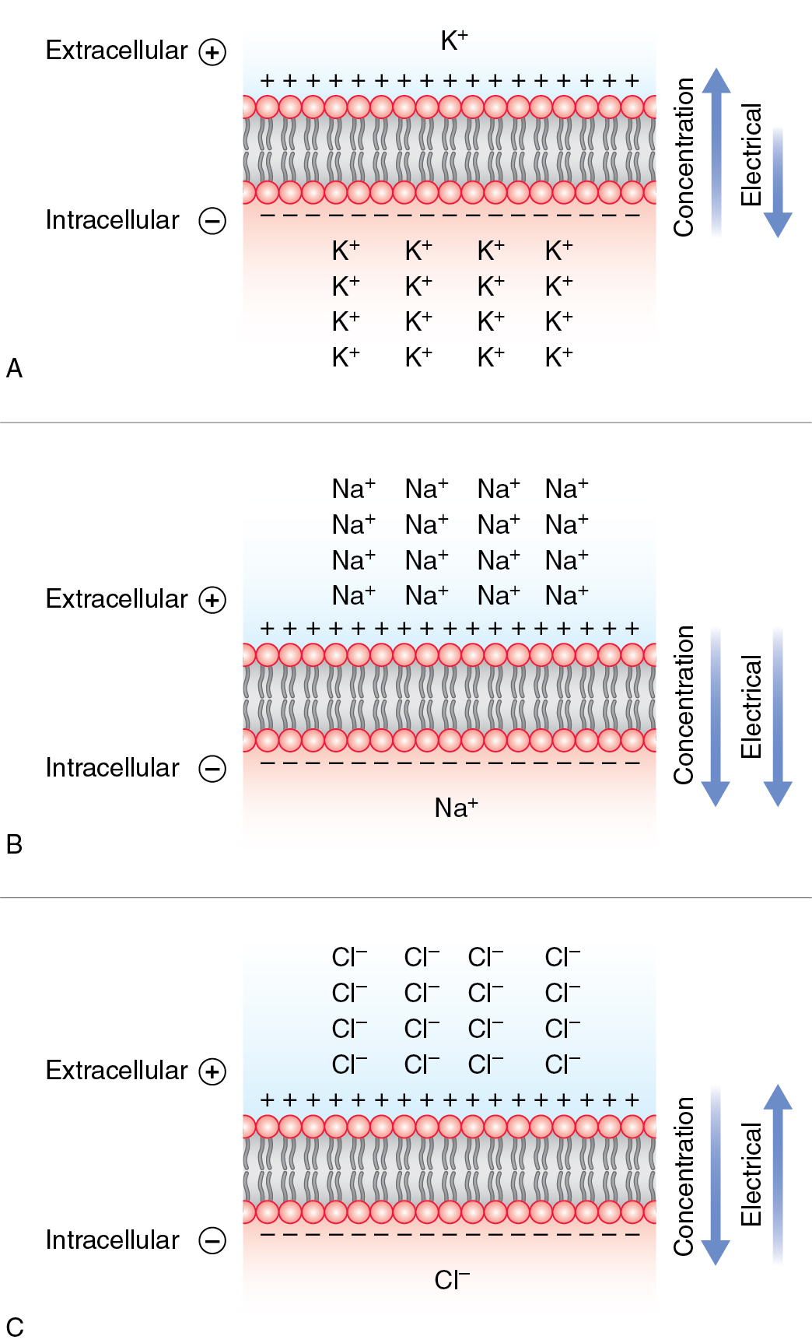
The electrochemical gradients established for different ions in a stable membrane (Some facts)
A. Large concentration gradient for K favours movement out of the cell but negative RMP partially opposes
B. Gradients favours Na movement inside. Only the relative non-permeability of the membrane & action of Na-K Pump maintain this electrochemical gradient
C. Cl has inward concentration gradient but as it is (-)ve ly charged , the negative RMP opposes the inward movement
So what?

Slide 35
All the potentials generated by the different ion gradients sum to give the Resting Membrane Potential (RMP) of the entire membrane
E_{m} ≅ -70 mV (RMP)
- The Goldmann Equation
The RMP is much closer to E_{K} (-86 mV) than it is to E_{Na} (+60 mV). Why?
The biggest weighting will be given to the ion that is the most permeable - K+.
P_{K+} >> P_{Na+} >> P_{Cl}- >> P_{protein}

Slide 36
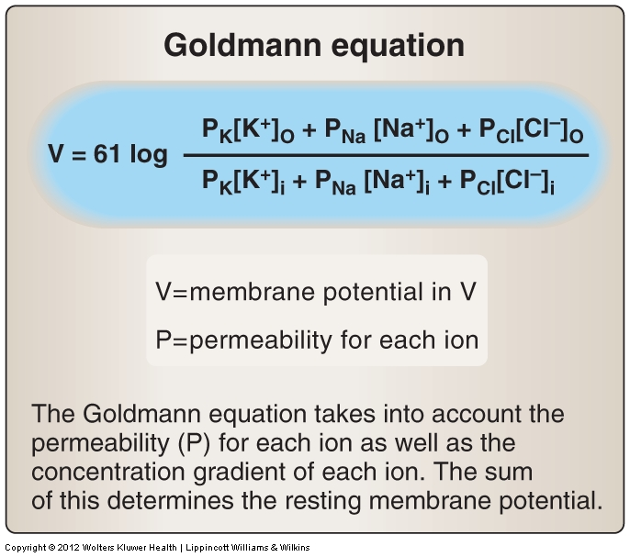
Notes:
Extension of nernst equation.
Need to consider several permeable ions

Slide 37
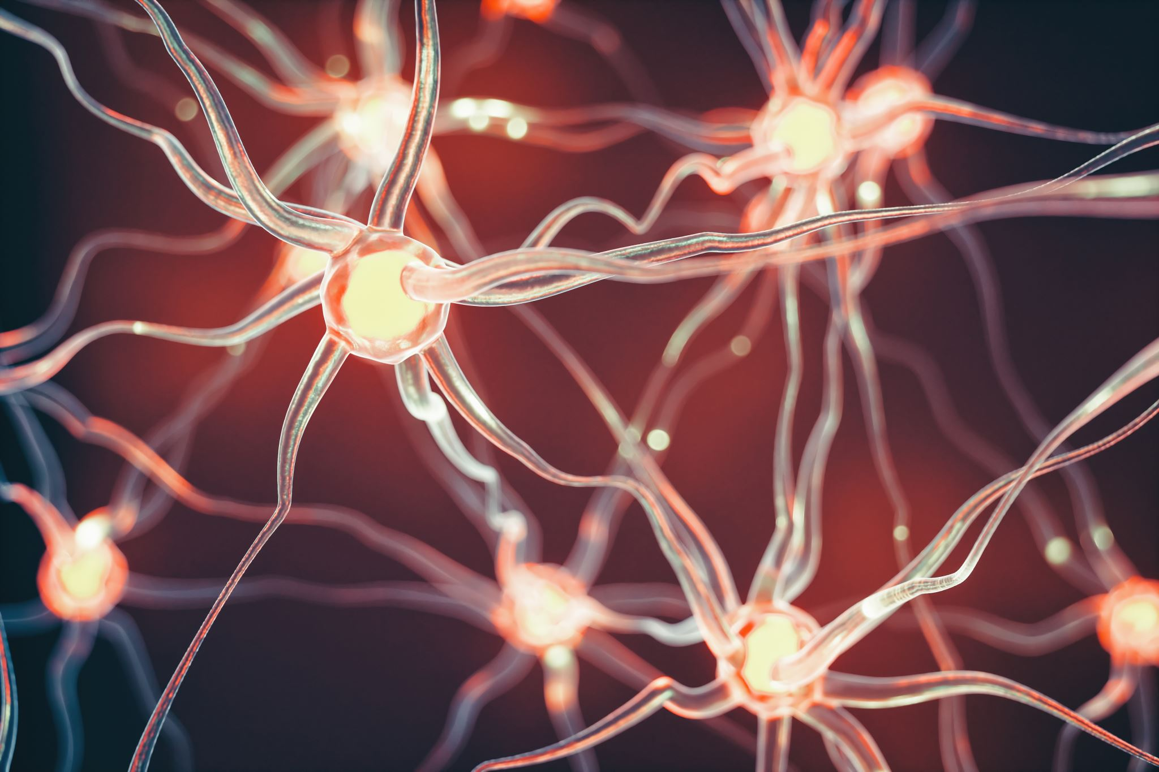
Why is membrane potential important?
Key aspect of cellular homeostasis and cell function in electrically excitable tissue
Opening and closing of ion channels, and movement of ions across membrane is the fundamental basis of cellular electrophysiology of nerve impulses, cardiovascular heartbeat, muscle contractility
Action potentials – process and transmit information

Slide 38
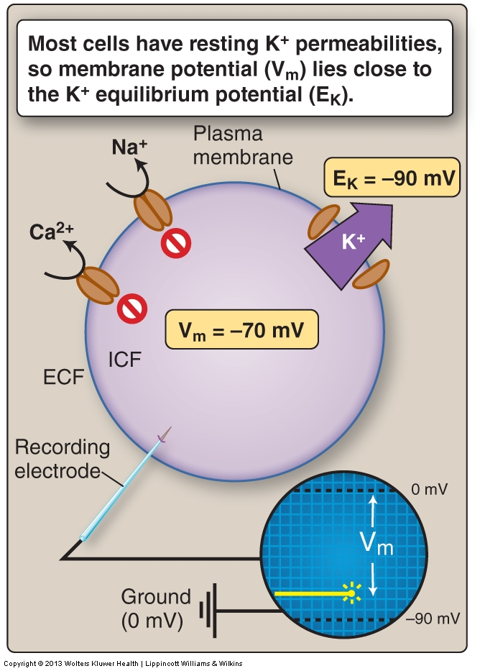
Resting Membrane Potential
SUMMARY
In most cells membrane potential relatively stable
Always negative inside the cell (at rest)
Arises from action of ion channels
Major determinant is K⁺ efflux through K⁺ ion channels (Leaky channels)
Any channel that transfers charge across the membrane has the potential to influence membrane potential
E_{K} = -80mV
Notes:
Major determinant is K, small amount of Na leak into cell

Slide 39
At the beginning of the lecture, we said:
An action potential is a rapid change in membrane potential
There is a very brief and rapid switch in permeability from K+ to Na+
P_{Na+} >> P_{K+} >> P_{Cl}- >> P_{protein}
The membrane potential therefore moves from the RMP (-70mV) towards E_{Na} (+60mV). This voltage change is called the action potential. [We will discuss it next……]

Slide 40
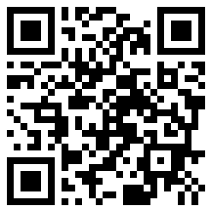
Join the Vevox session
Go to vevox.app
Enter the session ID: 165-606-947
Or scan the QR code

Slide 41
Action potential (2nd part)

Slide 42
Aims for this session…
Generation of the action potential
Movement of ions that underpin the generation of the action potential

Slide 43
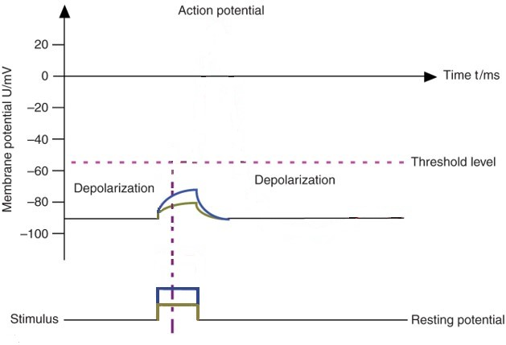
What determines how a neuronal cell responds to electrical activation?
Membrane potential
-55mV
-70mV
At rest, the cell will be at RMP
If neuron is activated the membrane will depolarise from RMP
Level of depolarisation will be proportional to the strength of the stimulus applied
Notes:
Threshold – is the point at which the Na entry is greater than K efflux… causes opening channels and more Na… positive feedback

Slide 44
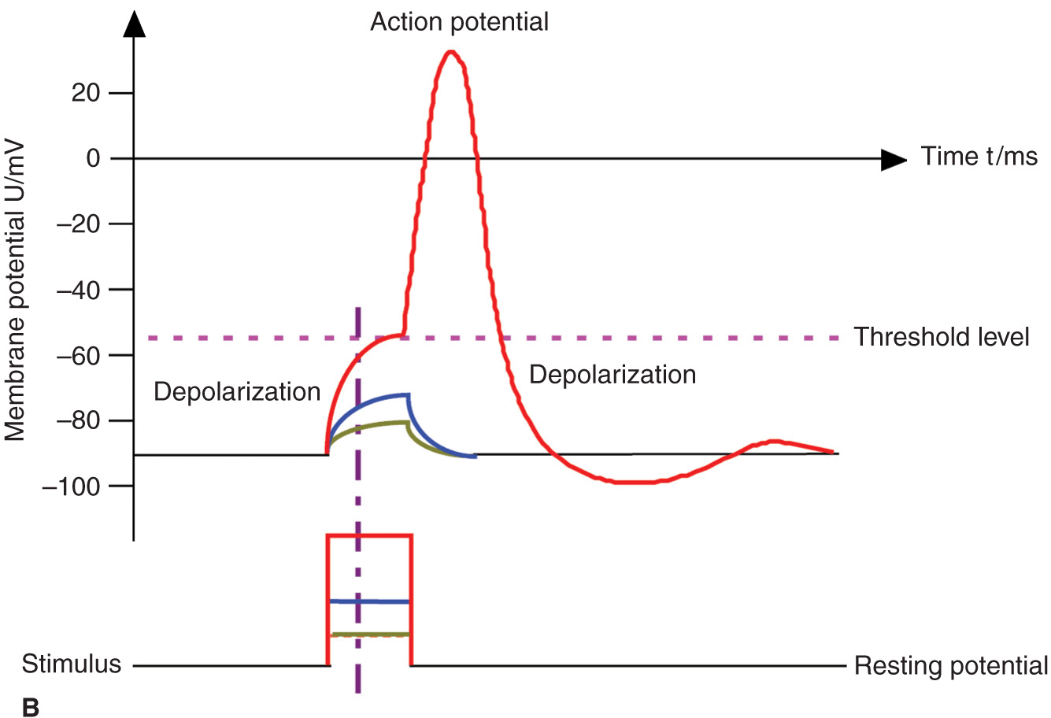
What determines how a neuronal cell responds to electrical activation?
Membrane potential
-55mV
-70mV
If membrane is sufficiently depolarised to a critical point ‘threshold’, generate an all-or-none event
  Action Potential
Notes:
Threshold – is the point at which the Na entry is greater than K efflux… causes opening channels and more Na… positive feedback

Slide 45
Transient increase in Na⁺ permeability underlies the generation of the action potential
Changes in ion permeability (K⁺ and Na⁺)
Open / close of ion channels
Change in ion permeability will cause a change in membrane potential
Threshold is the point where Na entry is greater than K efflux
For neuron to generate an action potential the membrane potential must reach the threshold
Notes:
For AP to occur – must reach a certain membrane potential around -55mV – depending on the cell (Silverthorn, p267)

Slide 46
All or nothing…
Supra-threshold stimuli
Sub-threshold stimuli
+ve
Hyperpolarising stimuli
Depolarisation and all or nothing
action potential
Membrane potential
mV
0
depolarisation
Threshold of excitation
-ve
hyperpolarisation
1
2
3
Time msec
Notes:
Hyperpolarising – further from threshold, less excitable
If stimulus not large enough to reach threshold – then AP not generated
Membrane depolarised to threshold or above then get an AP – all or none principle. Regardless of size of stimulus, if it reaches threshold will have same AP.

Slide 47
What is an action potential?
depolarisation
+30
repolarisation
-55
Membrane potential (mV)
hyperpolarisation
(undershoot)
-70
RMP
0
4
time (ms)

Slide 48
Ionic currents cross the membrane through voltage-gated channels:
the voltage-gated Na+ channel
opens and Na+ ions enter the cell
the voltage-gated K+ channel
  opens and K+ ions leave the cell
These channels are different from the Na⁺-K⁺ pump and the K⁺ leaky channel

Slide 49
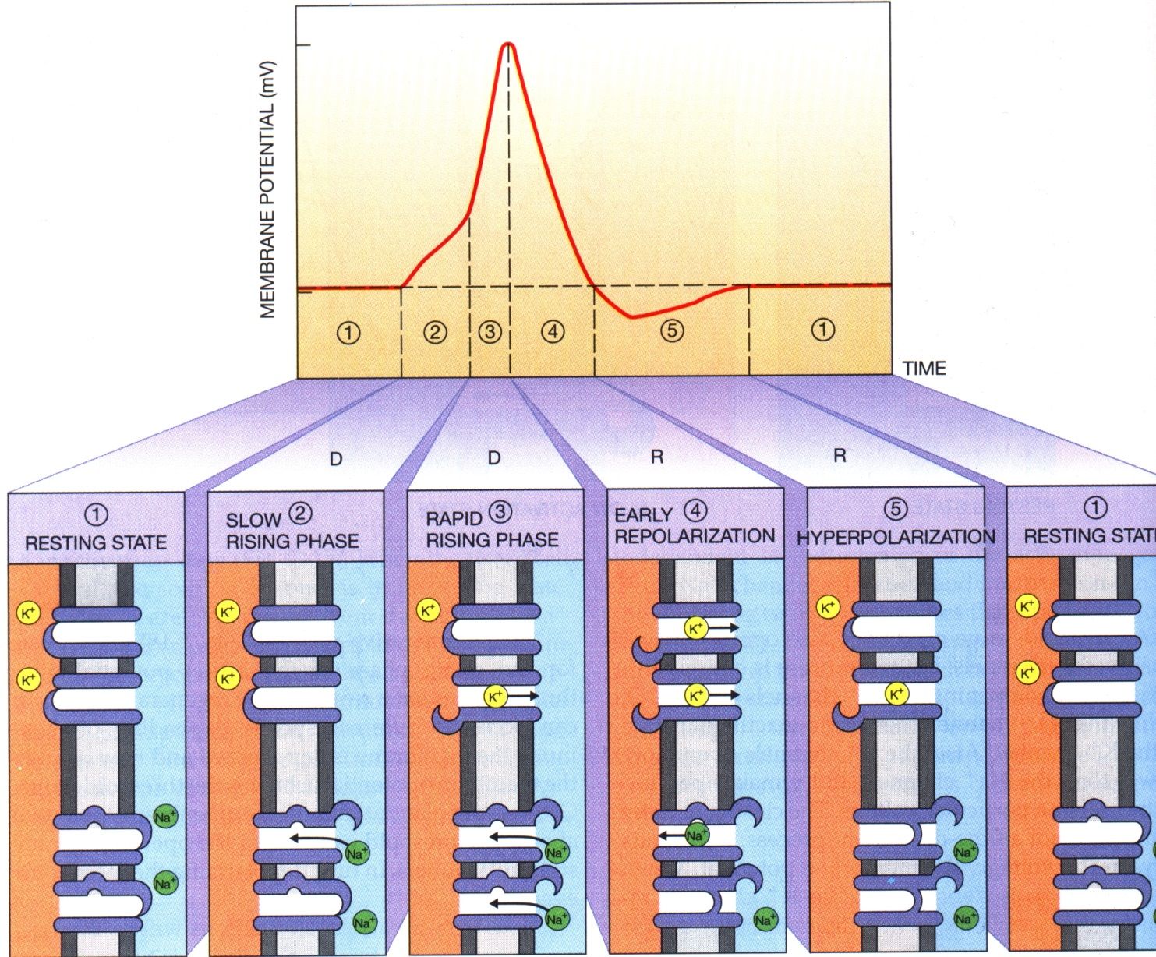
The phases of the action potential and corresponding movements of ions:

Slide 50
What is an action potential?
+60
E_{Na}
+30
Ion currents:
g_{Na+}
-15
g_{K+}
Membrane potential (mV)
-70
RMP
-86
E_{K}
time (ms)

Slide 51
The voltage-gated Na+ channel: (Your note)
When the membrane potential reaches about -55 mV
  (depolarisation of about 15 mV above the RMP of -70 mV)
the voltage-gated Na+ channel opens very rapidly
Na+ rushes into the cell through the ‘activation’ gate of the channel
This results in depolarisation phase

Slide 52
The voltage-gated Na+ channel:
activation gate open
inactivation gate closed
activation gate closed
(voltage-dependent)
(time-dependent)
(time-dependent)

Slide 53
The voltage-gated Na+ channel:
fast; automatic
slow; automatic
open
inactivated
closed
fast; voltage-gated

Slide 54
The voltage-gated K+ channel:
opens when the membrane is depolarised, but more slowly than the Na+ channel
closes slowly in response to membrane repolarisation

Slide 55
The voltage-gated K+ channel:
slow; voltage-gated
open
closed
slow; voltage-gated

Slide 56
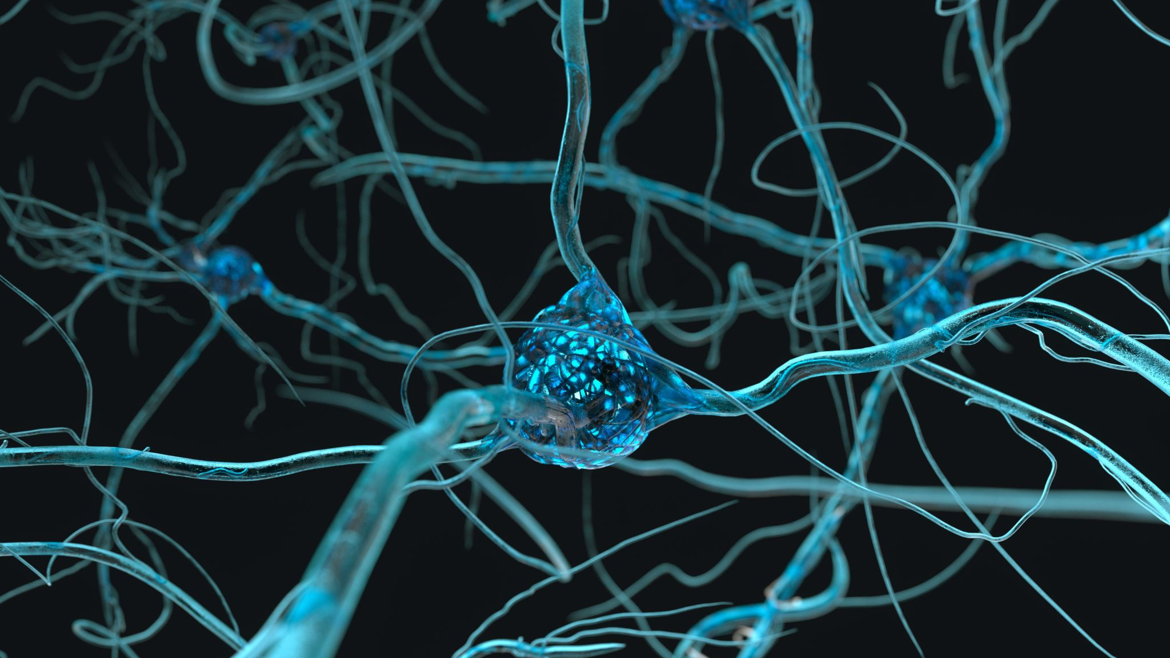
During the action potential the cell is refractory to further action potentials…
Why?
What are the refractory periods?
What is the cause?
Notes:
VGNaC inactivated
VGKC are open and causes hyperpolarisation

Slide 57
The absolute refractory period:
The refractory period
The period in which the membrane cannot generate another a.p. no matter how big the stimulus
  the Na+ channels are inactivated
The relative refractory period:
The period in which the membrane can generate another a.p., but only if the stimulus is bigger than normal
  some Na+ channels are recovered
  some K+ channels are still open

Slide 58
The refractory period
absolute refractory period
+30
-15
Membrane potential (mV)
relative refractory period
-70
time (ms)
Notes:
Relative refractory : Some Na channels have re-opened, but threshold higher than normal due to hyperpolarisation, need a stronger than normal stimulus to raise membrane potential to threshold
High permeability to K. Goes to more negative membrane potential.

Slide 59
Where does the action potential start?
Anterograde : Cell body to terminal
Retrograde : Terminal to cell body
dendrites
axon hillock
axon
axon terminal
synapse
cell body
Notes:
Certain pathogens exploit retrograde transport to invade the nervous system. Upon exposure to distal axon terminals, they are able to “hitch-hike” back to the cell soma. Known examples include tetanus toxin, herpes simplex virus, rabies virus, and poliovirus. Thus onset of symptoms will be delayed according to the length of time required for retrograde transport.

Slide 60
Once an a.p. has been generated in the axon hillock, how does it travel down the axon?
segment of an axon
++++
- - - -
++++
++++
++++
- - - -
++++
- - - -
- - - -
- - - -
action potential
at rest
at rest

Slide 61
The action potential travels via current loops.
++++
- - - -
++++
++++
++++
- - - -
++++
- - - -
- - - -
- - - -
action potential
at rest
at rest

Slide 62
The action potential travels via current loops.
++++
++++
- - - -
++++
++++
- - - -
- - - -
++++
- - - -
- - - -
action potential
at rest
at rest

Slide 63
The action potential travels via current loops.
++++
++++
++++
- - - -
++++
- - - -
- - - -
- - - -
++++
- - - -
action potential
at rest

Slide 64
The action potential travels via current loops.
++++
++++
++++
++++
- - - -
- - - -
- - - -
- - - -
- - - -
++++
action potential
at rest

Slide 65
The nearby area is depolarised by the current loop -- and another a.p. is set off, and so it goes, down the axon.
++++
++++
++++
++++
- - - -
- - - -
- - - -
- - - -
- - - -
++++
action potential
at rest

Slide 66
What prevents the a.p. moving in the opposite direction?
?
++++
++++
++++
++++
- - - -
- - - -
- - - -
- - - -
- - - -
++++
Na+ channels are inactivated due to hyperpolarization
at rest
action potential
The refractory period prevents AP to be moved in opposite direction

Slide 67
Why are refractory periods important?
Sets frequency action potentials are generated
Limits rate signals can be transmitted
Ensures one way travel of action potential
Notes:
Duration of refractory period determines max frequency at which an action potential can occur.

Slide 68
How fast does the action potential travel?
The velocity of the action potential, V, is related to:
  D = diameter
  R_{m}= membrane resistance
D
R_{m}
V ∝
D x R_{m}

Slide 69
How fast does the action potential travel?
V ∝
D x R_{m}
D: the larger the diameter, the more room for local current flow in current loops
R_{m}: the higher the membrane resistance, the less current is lost by leaking out of the cell. More current therefore stays in current loops

Slide 70
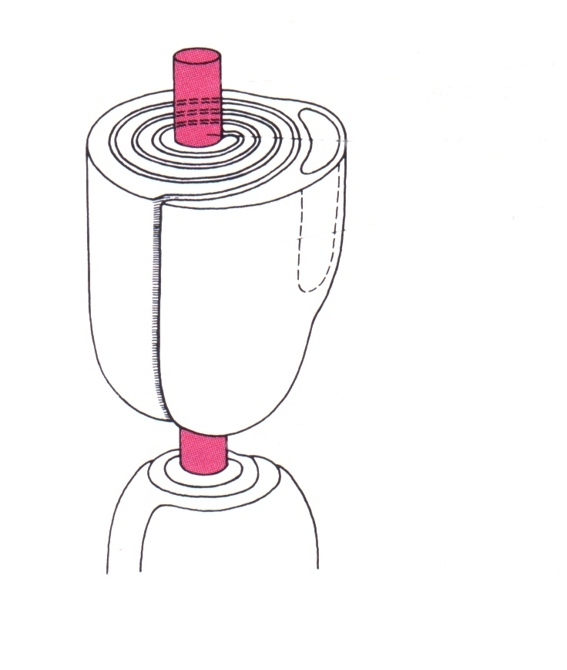
Myelination:
axon
myelin sheath
node of Ranvier
-occur every 1-2mm
-are ~1μm wide

Slide 71
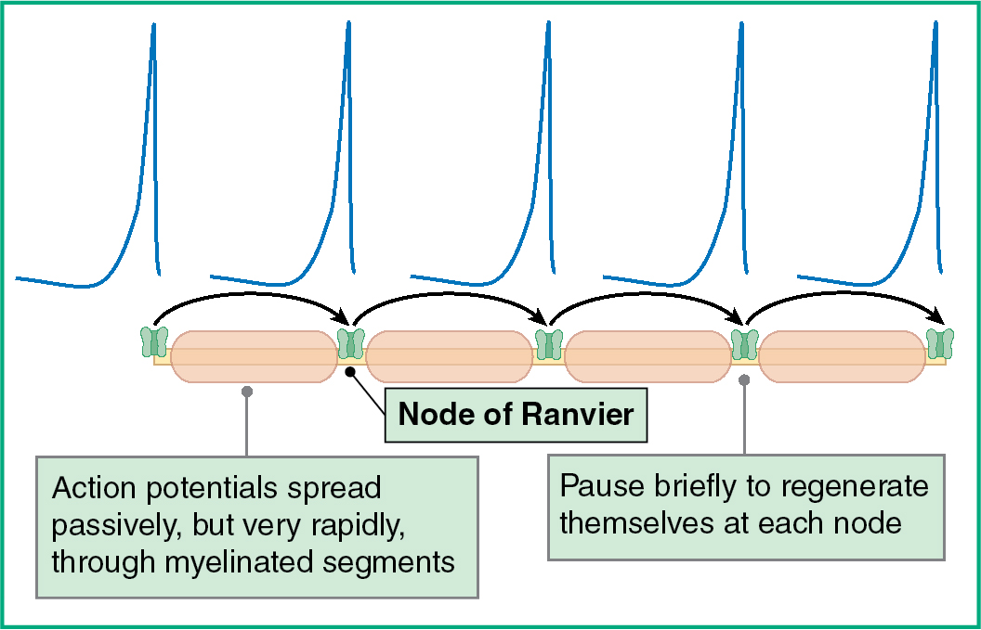
What happens at a node of Ranvier?
nodes of Ranvier
-high density of Na⁺ channels
++
current jumps from node to node:
Saltatory Conduction
--
--
++

Slide 72
In a myelinated axon: (Some facts)
How much does myelin contribute to increased conduction velocity?
a myelinated axon has a greater conductivity velocity than an unmyelinated axon that is 100 times larger in diameter
a myelinated axon 20 μm wide has an a.p. velocity of 120 m/sec
an unmyelinated axon 1 μm wide has an a.p. velocity of ~2 m/sec.

Slide 73
What happens when myelinated neurons become demyelinated?
Range of diseases: Multiple sclerosis (CNS), Guillain Barré syndrome (PNS), Tabes dorsalis (PNS) etc.
Multiple sclerosis potentially debilitating disease.
Demyelination is scattered and progressive, leading to a gradual loss of motor control. Scanning speech (unclear speech), intention tremor, nystagmus, optic neuritis (sudden vision loss), hemiparesis (Inability to move on one side/weakness) , incontinence (inability to control the release of urine or stool).
Has no cure. However, treatments may help treat MS attacks, manage symptoms and reduce progress of the disease
Notes:
It is the most common neurological disorder among young adults and affects ~ 85,000 people in the UK.
demyelination of axons in the nervous system results in a.p’s being unable to jump between nodes of Ranvier, so a.p. propagation ceases
Damage to myelin causes interference in the communication between your brain, spinal cord and other areas of your body. This condition may result in deterioration of the nerves themselves, a process that's not reversible.
Symptoms vary widely, depending on the amount of damage and the nerves that are affected. People with severe cases of multiple sclerosis may lose the ability to walk or speak clearly. Multiple sclerosis can be difficult to diagnose early in the course of the disease because symptoms often come and go — sometimes disappearing for months. Symptoms: Scanning speech, intention tremor, nystagmus, optic neuritis (sudden vision loss), hemiparesis, incontinence.
Other examples of myelinated diseases: Guillain Barré syndrome (PNS) : Symmetric ascending muscle weakness/paralysis
Tabes dorsalis : (PNS) : Impaired sensation and proprioception worst in lower extremities
Multiple sclerosis has no cure. However, treatments may help treat MS attacks, manage symptoms and reduce progress of the disease.

Slide 74
SUMMARY
An action potential is a transient change in RMP
It is caused by an influx of Na+ ions and an efflux of K+ ions, through voltage-dependent ion channels
The action potential is propagated down the axon by means of current loops
The refractory period prevents the action potential from being set off backwards

Slide 75
Important Terminologies :
Membrane potential (V_{m}): The voltage difference across the cell membrane at any given moment. In a resting neuron, it is approximately –70 mV. 2. Resting membrane potential (RMP):The membrane potential when an excitable cell is at rest. It is mainly determined by K⁺ movement through K⁺ leak channels, with a smaller contribution from Na⁺. 3. Electrochemical gradient: The combined effect of the concentration gradient and electrical gradient acting on an ion. Together, they determine the tendency of an ion to move across the membrane. 4. Equilibrium potential (E_{ion}): The membrane voltage at which the electrical gradient exactly balances the concentration gradient for a particular ion, resulting in no net movement of that ion

Slide 76
Important Terminologies :
5. Threshold: The critical membrane potential that must be reached to trigger an action potential. In the lecture, it is approximately –55 mV for a typical neuron. 6. Inactivation gate: A part of the voltage-gated Na⁺ channel that closes shortly after the channel opens. It stops further Na⁺ entry and helps terminate the depolarisation phase. The channel must recover from inactivation before it can open normally again. 7. Refractory period: The period following an action potential when another action potential is difficult or impossible to generate. Has two types. 8. Saltatory conduction: In a myelinated axon, the action potential effectively jumps from one node of Ranvier to the next, allowing rapid conduction along the axon. 9. Guillain Barré syndrome (PNS) : Symmetric ascending muscle weakness/paralysis ; Tabes dorsalis : (PNS) : Impaired sensation and proprioception worst in lower extremities.

Slide 77

Let's stop a while,
Please attempt few questions…..

Slide 78
Join the Vevox session
Go to vevox.app
Enter the session ID: 165-606-947
Or scan the QR code

Slide 79
Thank you.
Any questions??

